Slide 1
TODO
Log Analyzer web-page screenshot is indistinguishable – do something to make it visible
Visualize statistics produced by Log Analyzer
Add web link to the Applications
[optional] White background looks not so good – change?
[optional] QR codes for web links

Slide 2
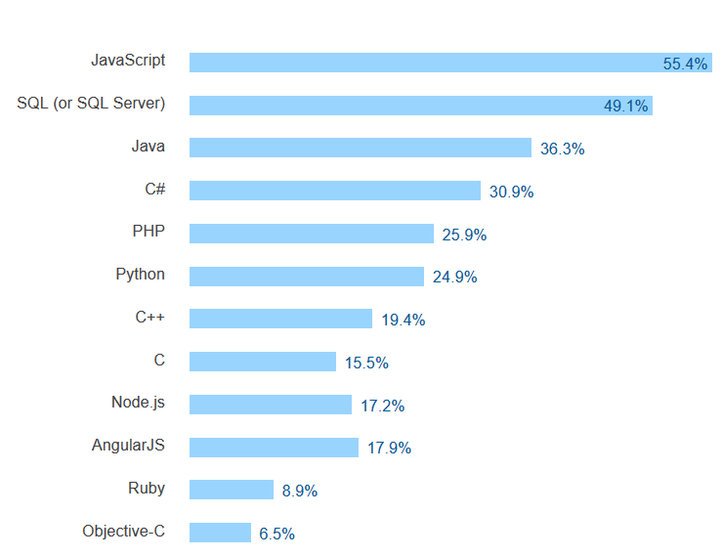
Why Reference Applications in Java?
Stack Overflow survey 2016: Most popular technologies
Where is Scala?
http://stackoverflow.com/research/developer-survey-2016#technology

Slide 3
Databricks Reference Applications in Java
Only to Log Analyzer application
No Twitter Language Classifier, no Weather Time Series
Spark 2.0
Java 8

Slide 4
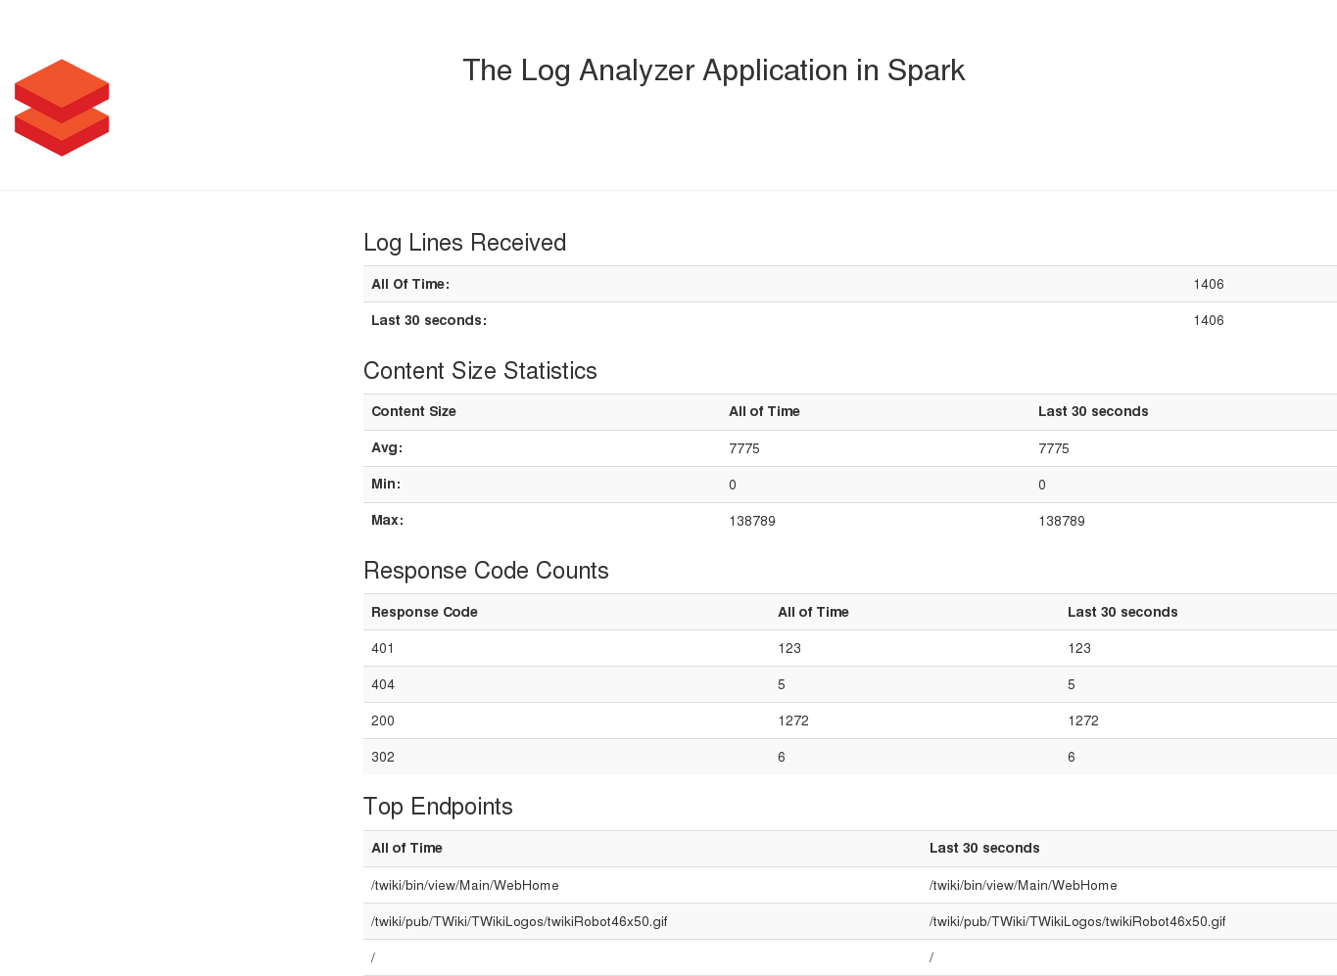
Log Analyzer Structure
Chapters 1-3: Learn basic Spark features
Chapter 4: Apply new knowledge in Log Analyzer Application
Apache web server access statistics

Slide 5
Statistics from Log Analyzer
Statistics on HTTP requests
content size: min / max / average
response code counts
clients accessed the server more than 10 times
top 10 accessed endpoints
Sliding window and total
Real-time input data

Slide 6
Spark features in Log Analyzer
Spark Streaming
Directory polling: textFileStream()
Sliding window calculations: window()
Cumulative state update: updateStateByKey()
Transformations: map(), maptToPair(), filter()
Calculations: reduce() , reduceByKey(), min(), max()

Slide 7
Other Spark features in Chapters 1-3
Spark SQL API
Dataset concept
SQL queries
Spark Streaming API
DRY with foreachRDD() and Java 8 lambdas
Data output to file system
Small data
Large data

Slide 8
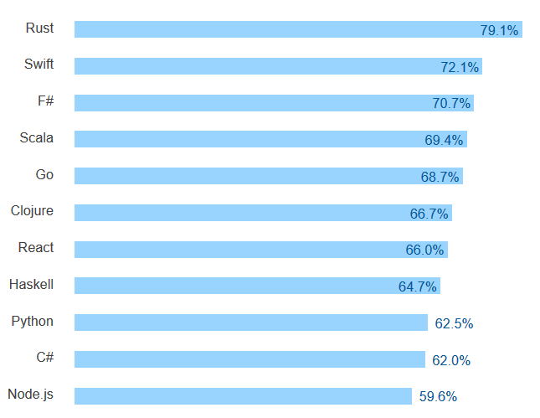
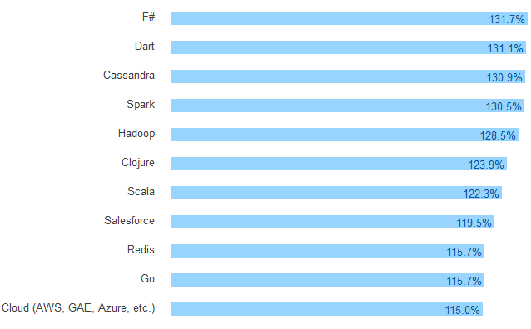
Java Ref Apps: For Java folks’ wealth and joy
Most loved technologies
Top paying technologies
Where is Java?
http://stackoverflow.com/research/developer-survey-2016#technology

